Slide 1
WEB DEVELOPMENT AND HCI
Dr. Mark Junjie Li
1

Slide 2
ABOUT ME
Dr. Mark Junjie Li
Associate Professor
Rm 613
jj.li@szu.edu.cn
Research Interests
    Data Mining, Machine Learning, Big Data
    Data Analytics Consultant in Manufacturing, Quantitative Finance, NLP for legal documents, Smart Grid

Slide 3
WEB DEVELOPMENT AND HCI
Facilitate you as the learner in developing skills in web technologies;
Will have to learn things yourself (ie, will not give you all the answers).
A different way of learning than you have perhaps been used to.
The goal is to encourage you to become ‘web practitioners’ able to work autonomously to solve problems and learn new skills as technology changes

Slide 4
TECHNOLOGY
Front End
Back End
HTML5
CSS3:Boostrap
Javascript (Jquery)
Java/Python/Php
Database: MySQL /Oracle
Going to be bringing all these technologies together, but will first work with each one individually.
The Web as we know it is dead. A paradigm shift in Web Technology
http://www.evolutionoftheweb.com

Slide 5
WHAT YOU WILL BE ABLE TO DO AT THE END OF THE MODULE
A appreciation of the typical workflow for website development
Plan and Analyse a problem domain
Ability to apply a mark-up solution
Programing skills for website implementation
  HTML/HTML5
  CSS/CSS3
  Javascript/Jquery/Vue
  Python/Php/Java (Optional)
  MySQL (Optional)
  Boostrap, Echart, etc.

Slide 6

TEXTBOOK

Slide 7
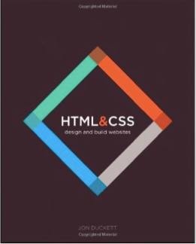
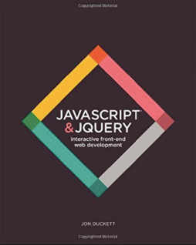
REFERENCE BOOK （CONT.）

Slide 8


REFERENCE BOOK

Slide 9


REFERENCE BOOK （CONT.）

Slide 10
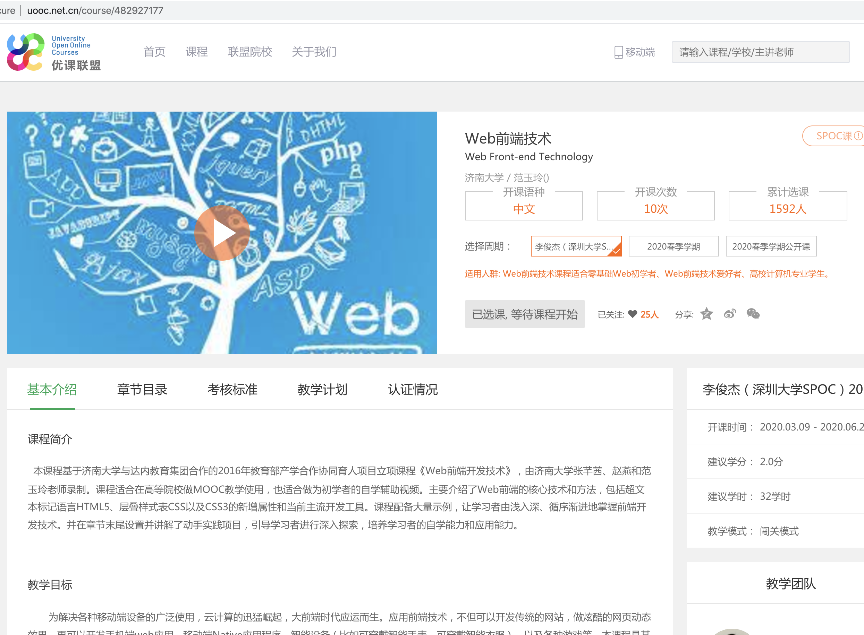
UOOC HTTP://WWW.UOOC.NET.CN/COURSE/482927177
网站开发基础知识 1周
HTML标记 2周
CSS初步 2周

Slide 11
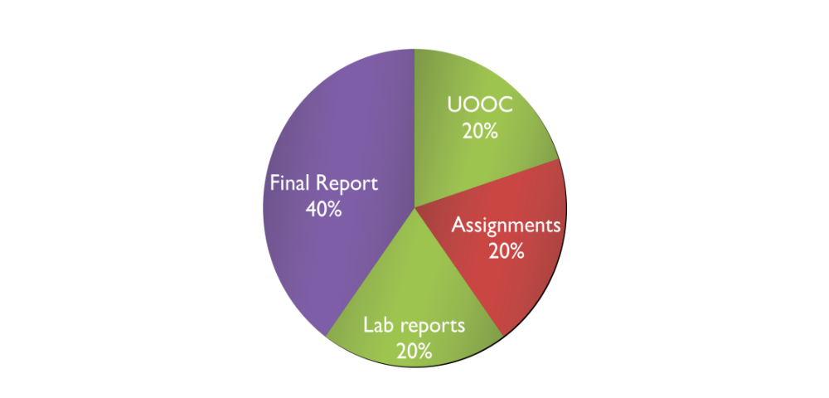
GRADING POLICY

